Slide 1
Placement Management System
Devansh Shah(21CS060)
Aakash Tadhani(21CS070)
Jenish Vekariya(21CS073)
Guide Name : Prof. Akshita Kadam

Slide 2
TABLE OF CONTENTS
01
02
03
04
05
06
Introduction
Problem Statement
Solution/Need of System
Functional/Non-Functional Requirements
Flow Diagram
Screenshot of Result
Design and Development Process
Flow Chart of System
Screenshots of UI/UX Design

Slide 3
Introduction
In today’s world everyone is travelling for jobs after Completion of their graduation.
It has became need for each and every student
The project is aimed at developing an online web application for the placement department of the college.

Slide 4
PROBLEM STATEMENT
The existing system is doing all the processes manually.
The Placement Officer should refer all the records kept for years ago to simply no details. This is tedious and time consuming.
This process is so difficult when the number of users increases.
There are a lot of limitations for the existing system.

Slide 5
03
Solution/Need of System

Slide 6
Functional Requirement
Software Interfaces :
Database: MySQL
Scripting Language: PHP, Hypertext Preprocessor and JavaScript
Web Browser: Any
Hardware Interfaces :
1. The program will communicate with hard drive(the filesystem and database) via the appropriate PHP code.
2. The user can communicate through browser using keyboard and a display through graphical interface displayed on user’s screen.
Communications Interfaces :
1. The requirements associated with any communications functions required by this product, including email, web browser, network server communications protocols, electronic forms, and so on.
2. Communication standards that will be used, Communication security or encryption issues will
handle by using java scripts.

Slide 7
Non-functional Requirements
Performance Requirements
Security Requirements
Software Quality Attributes
Any performance requirement in not needed. User’s network speed may increase performance
Security systems need database storage just like many other applications. However, the special requirements of the security market mean that vendors must choose their database partner carefully.
Availability
Correctness
Maintainability
Usability

Slide 8
04
Flow Diagram

Slide 9
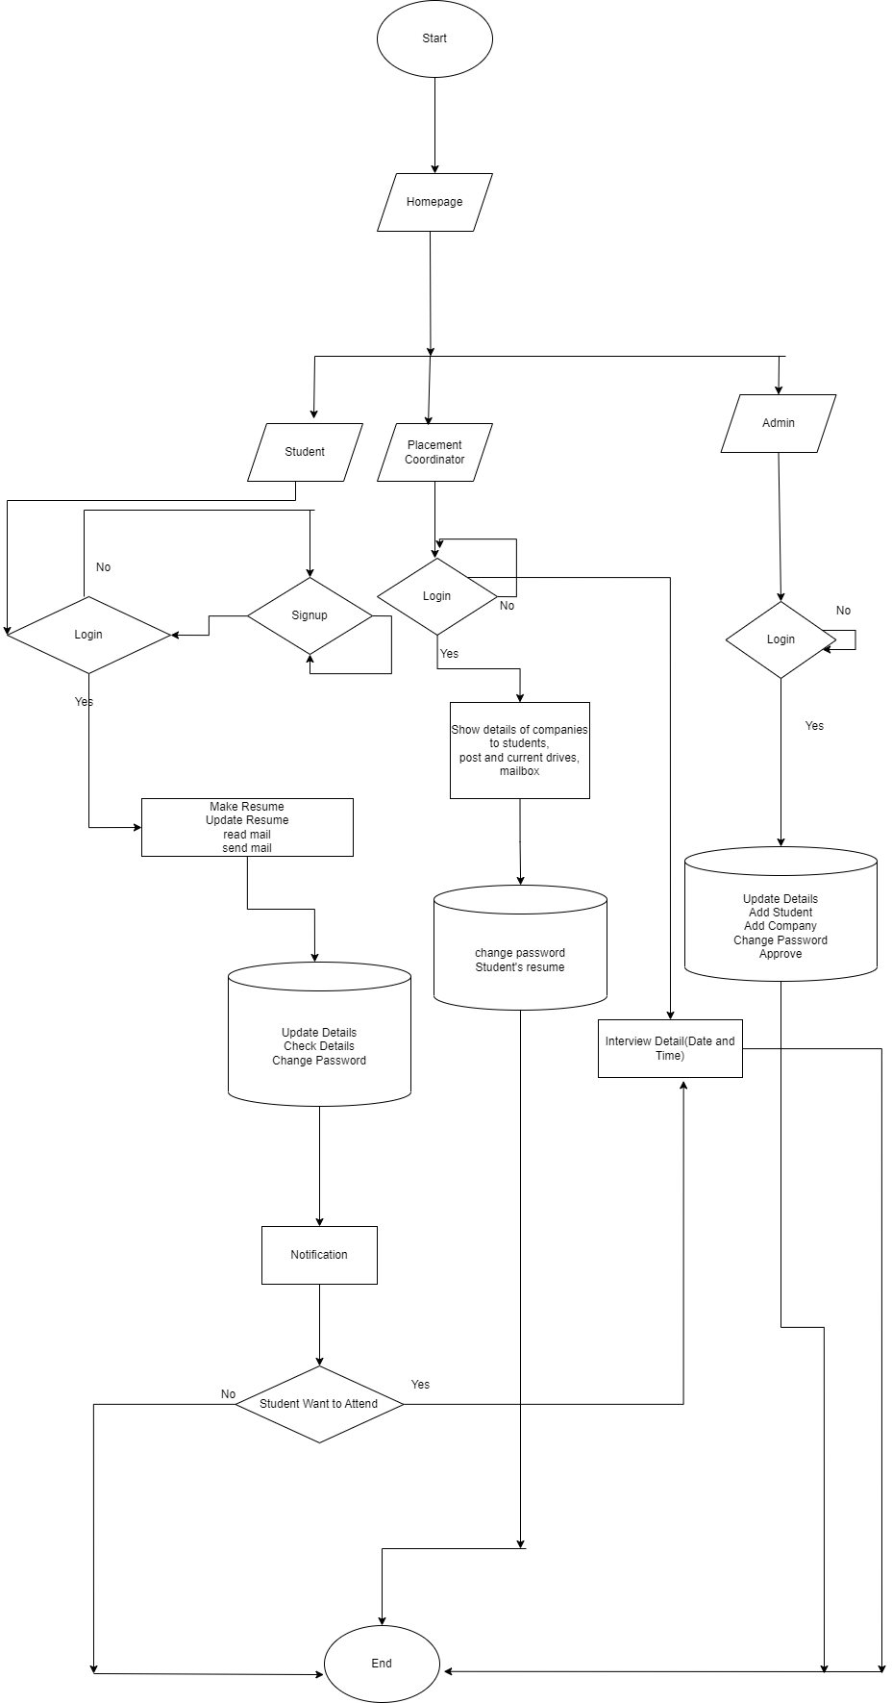

Slide 10
05
UI/UX Design

Slide 11

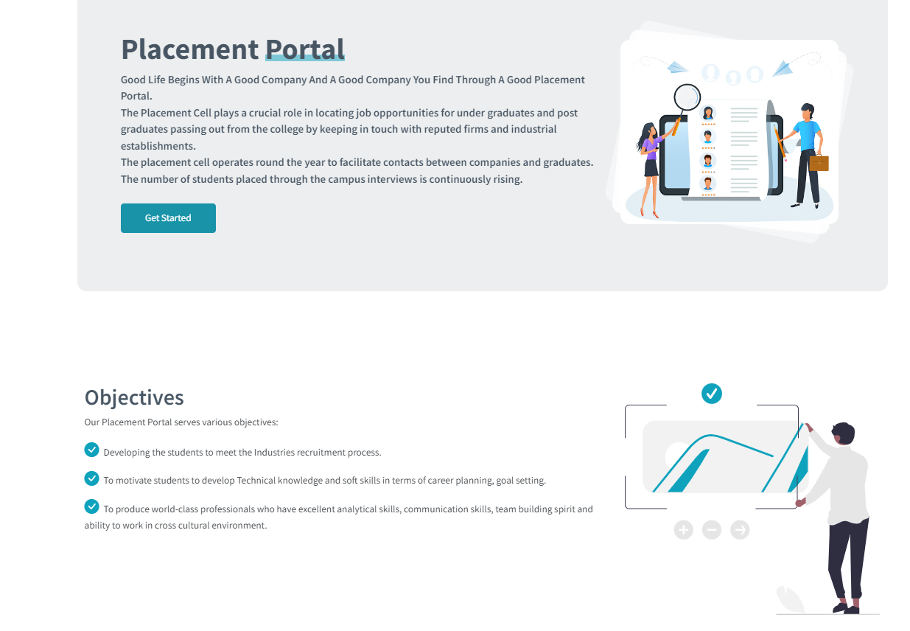
Home page

Slide 12
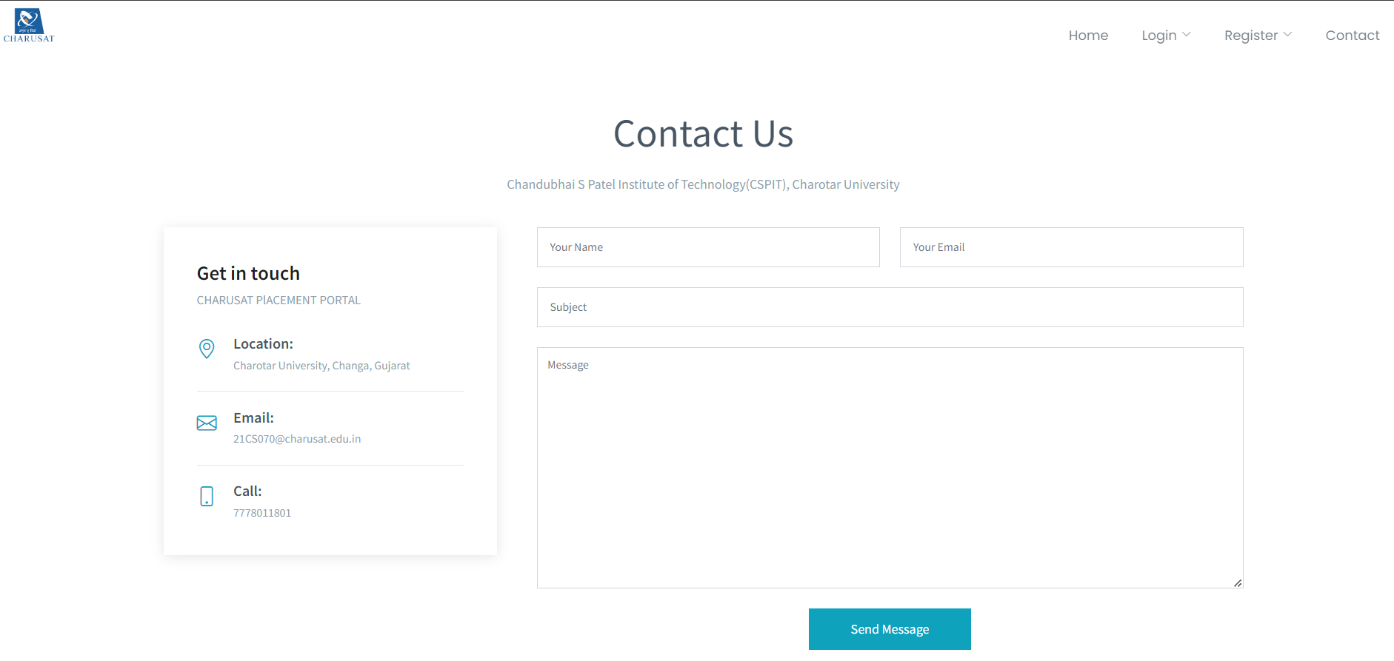
Contact Us

Slide 13
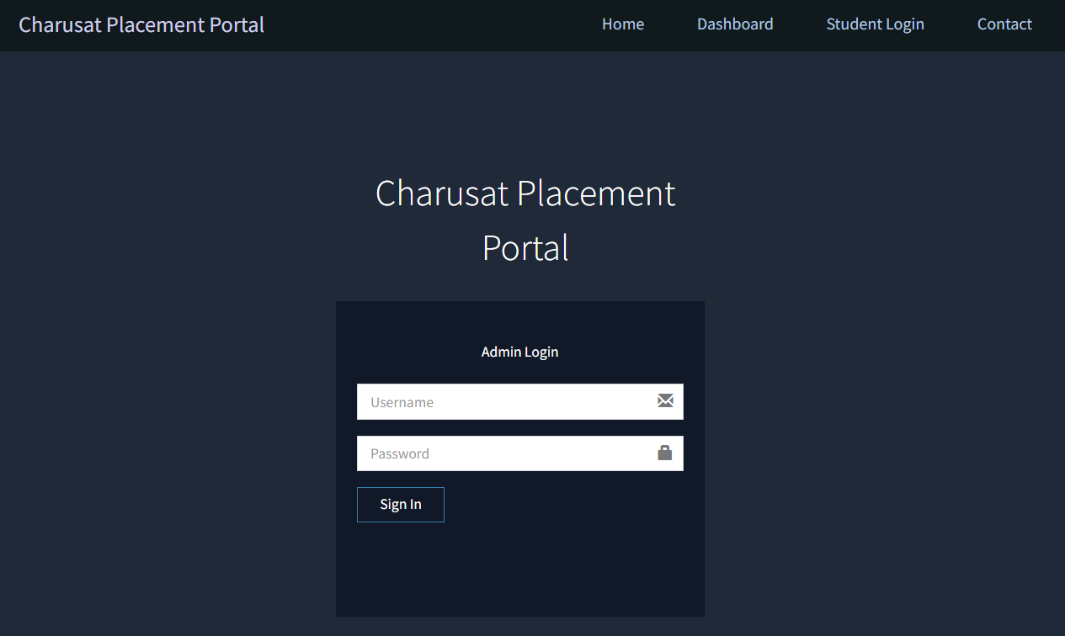
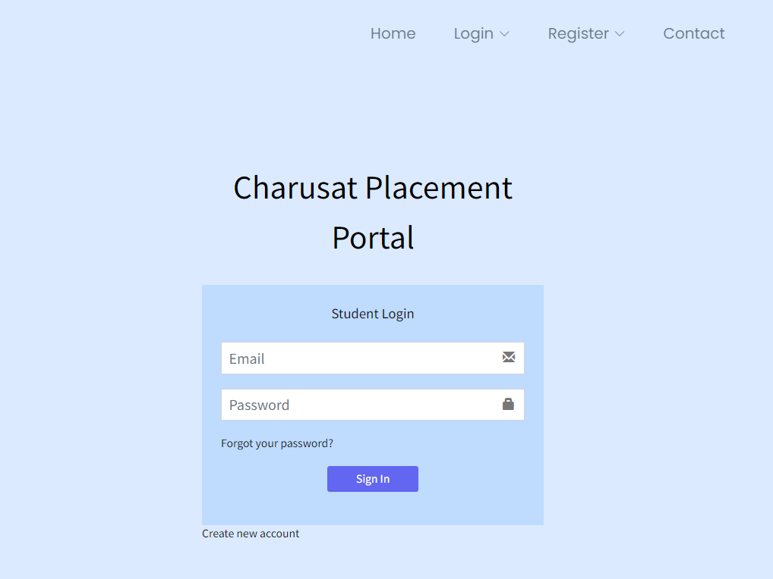
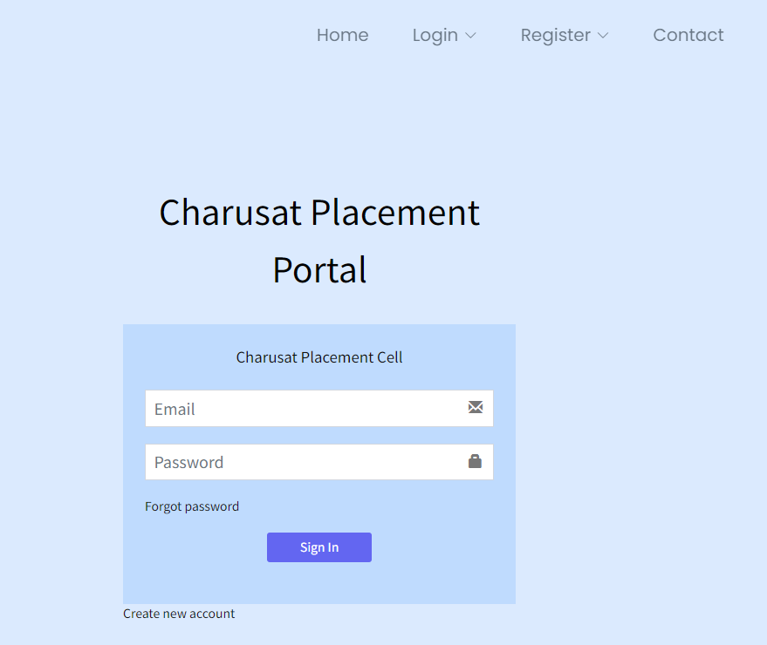
Login Page

Slide 14
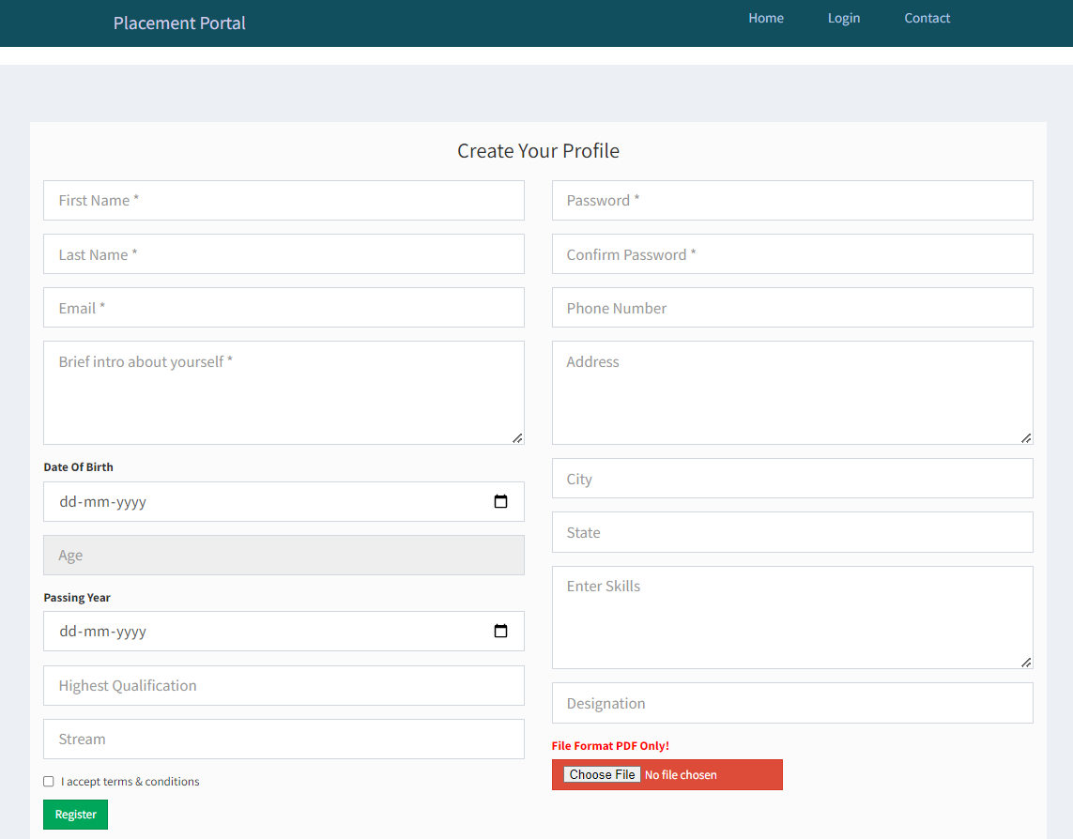
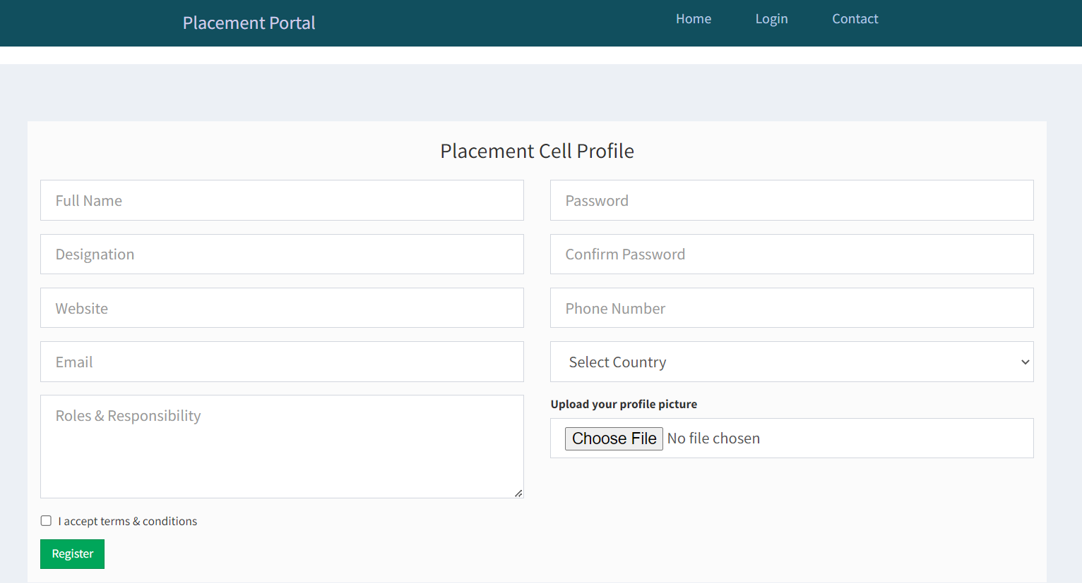
SIGN UP Page

Slide 15
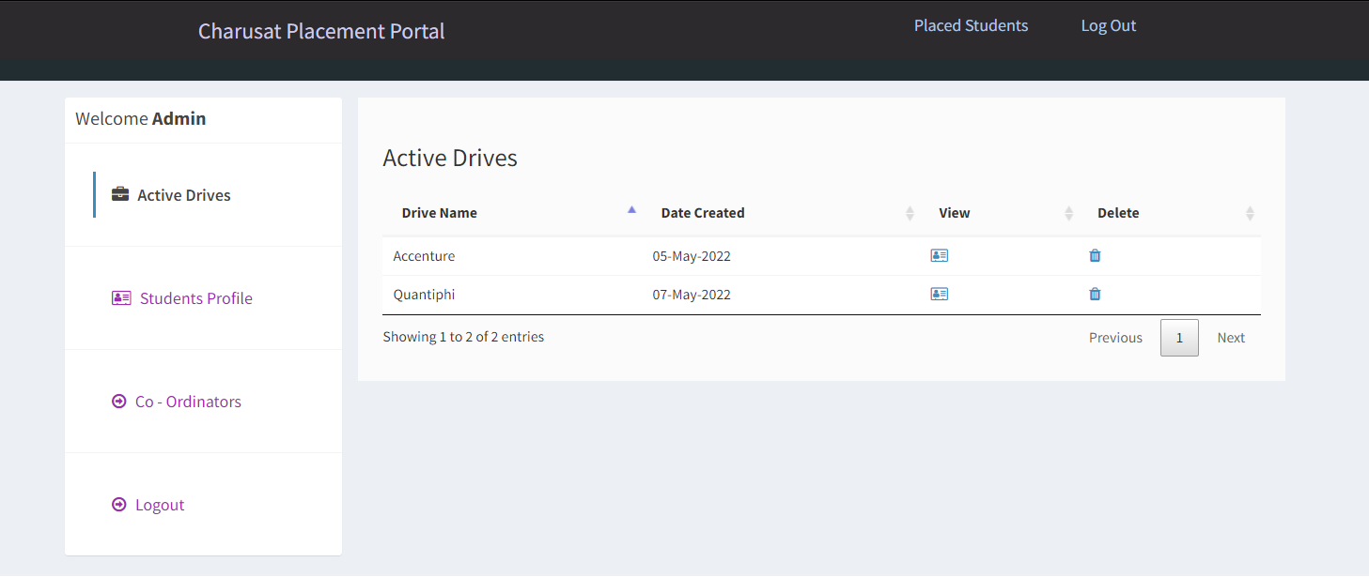
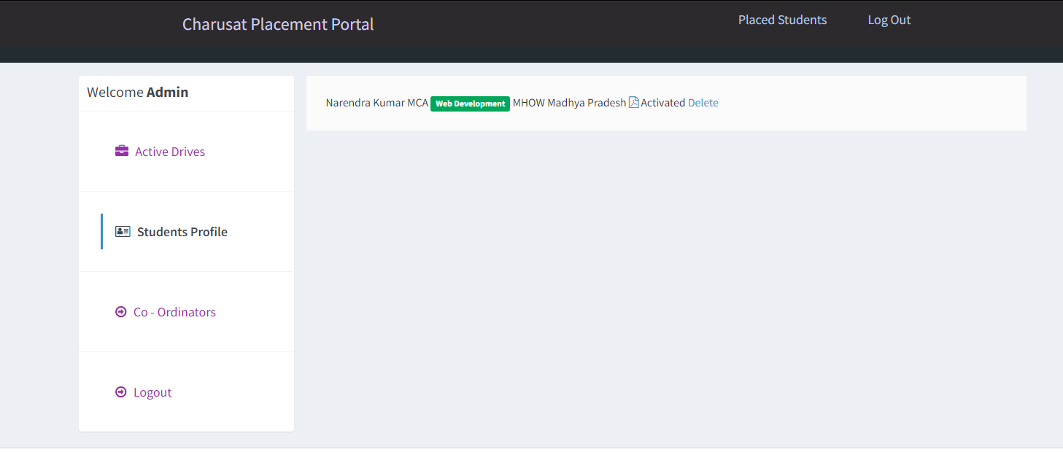
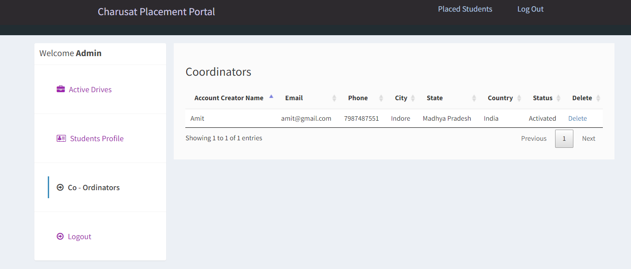
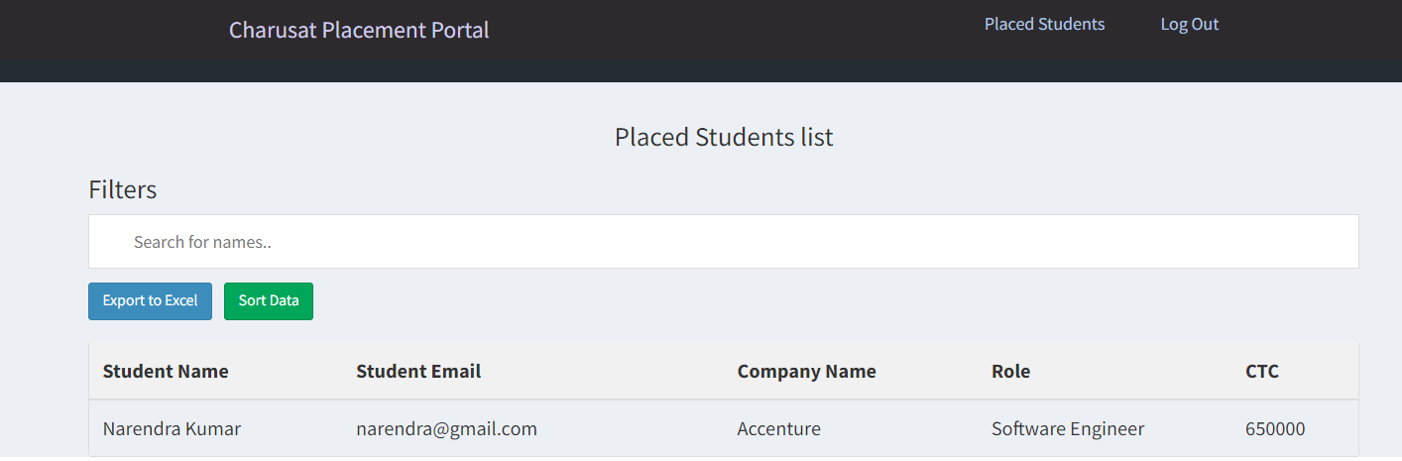
Admin Module

Slide 16
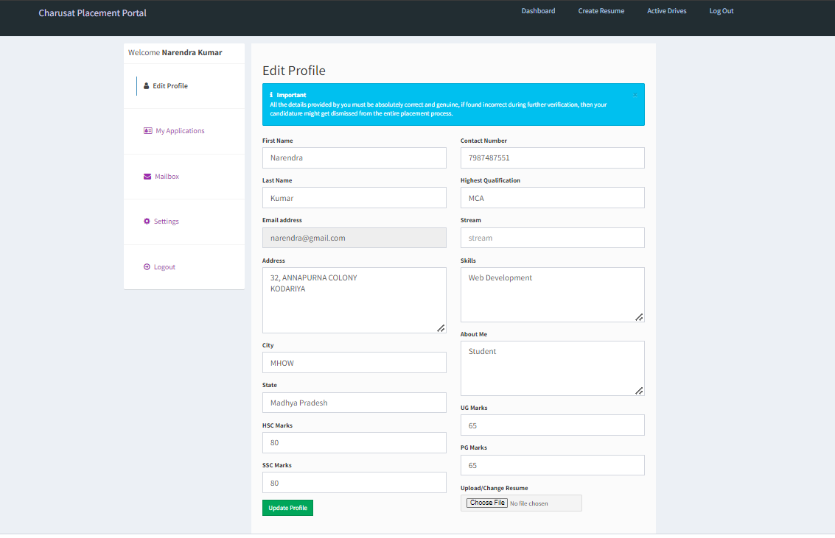
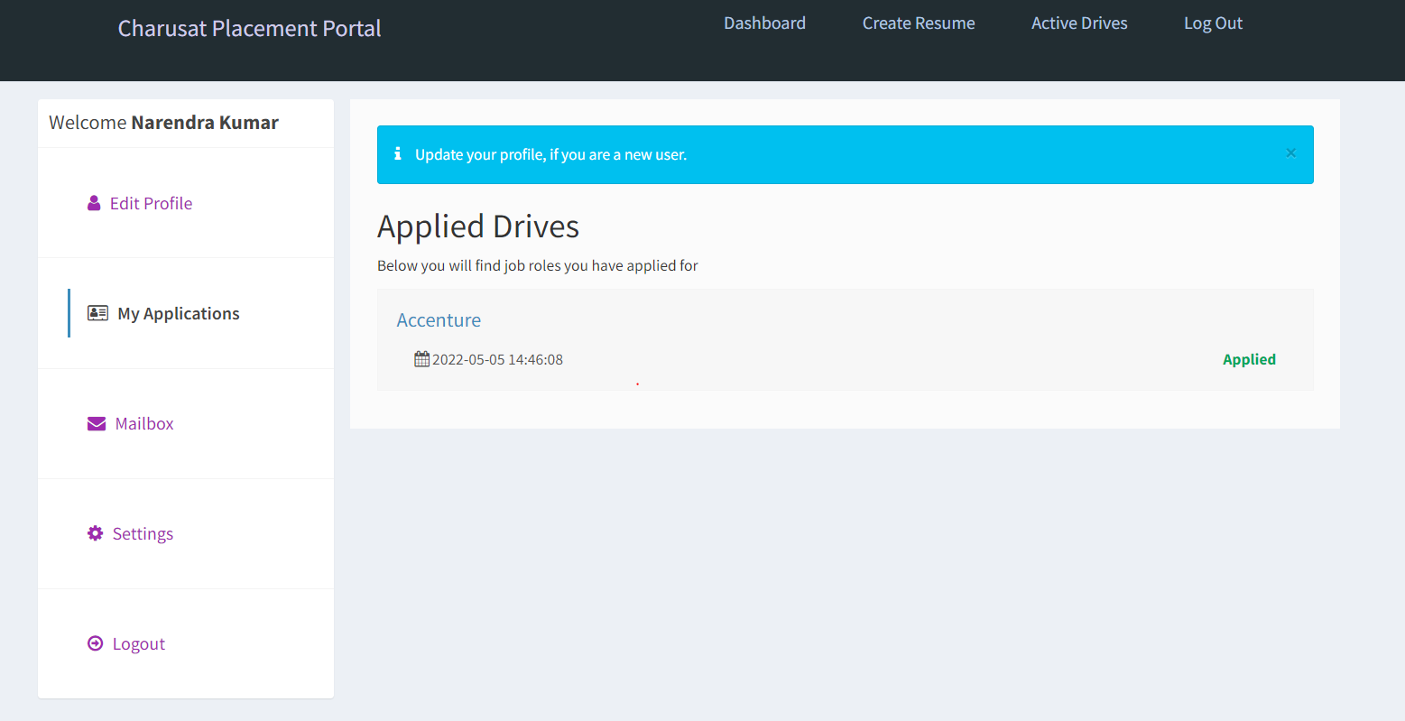
Student Module

Slide 17
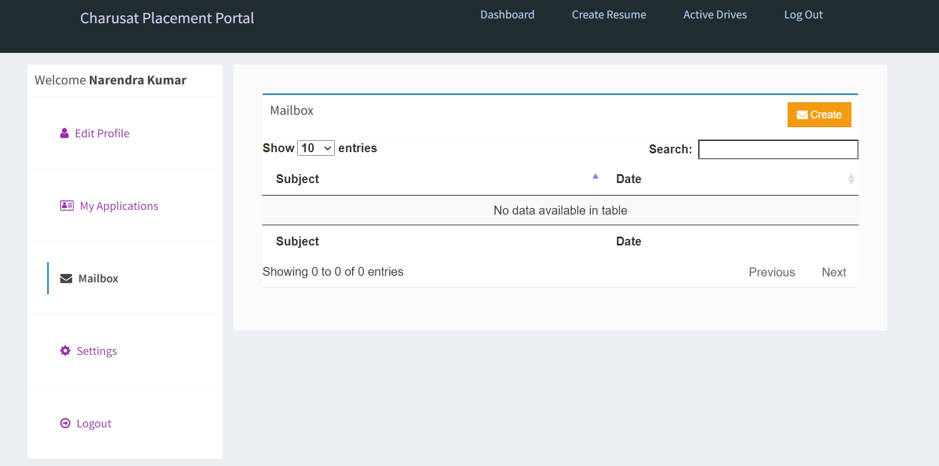
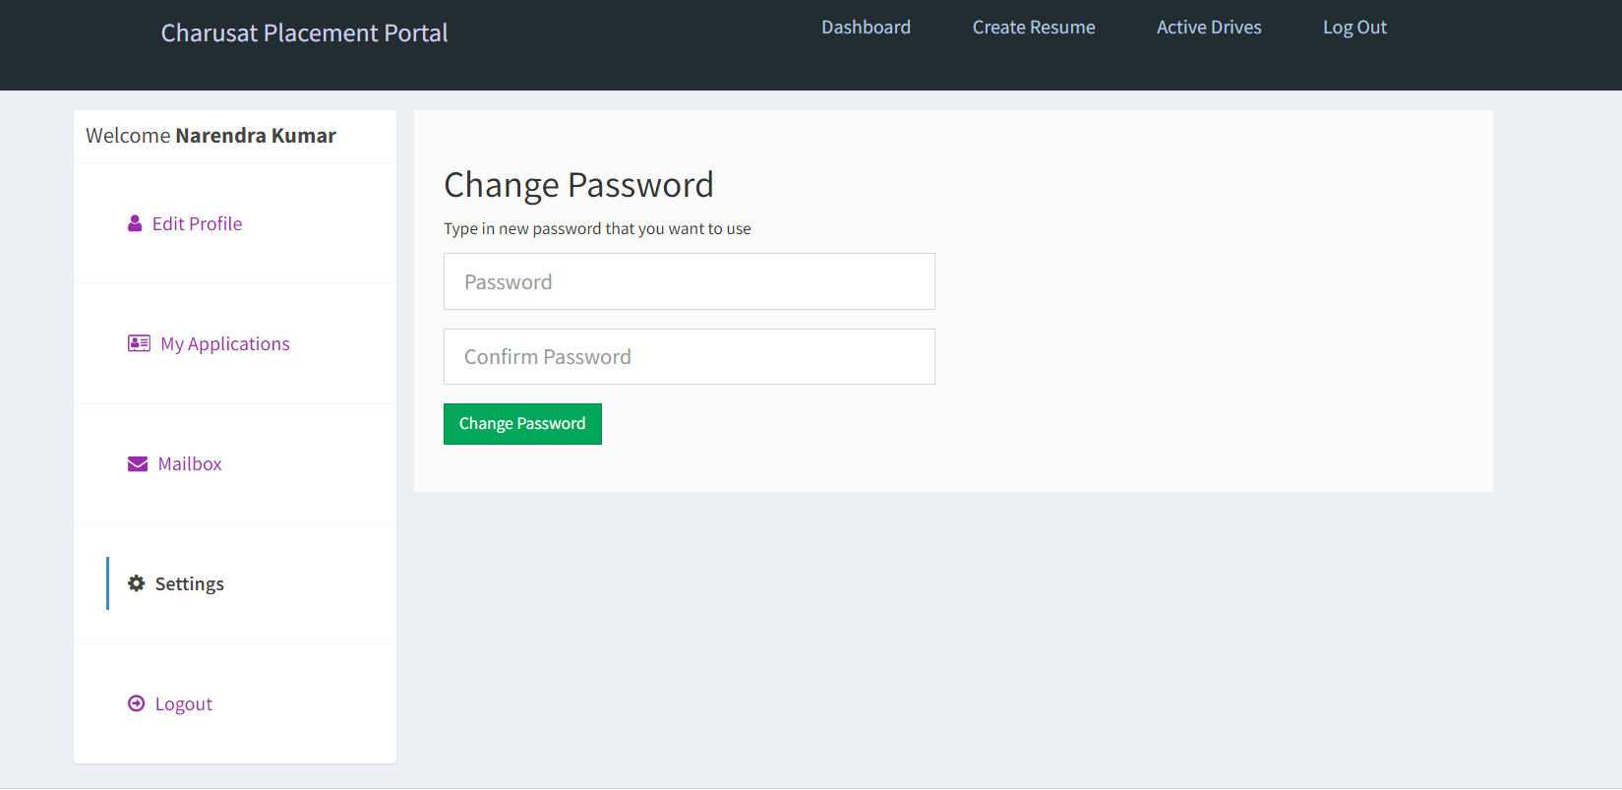
Student Module

Slide 18
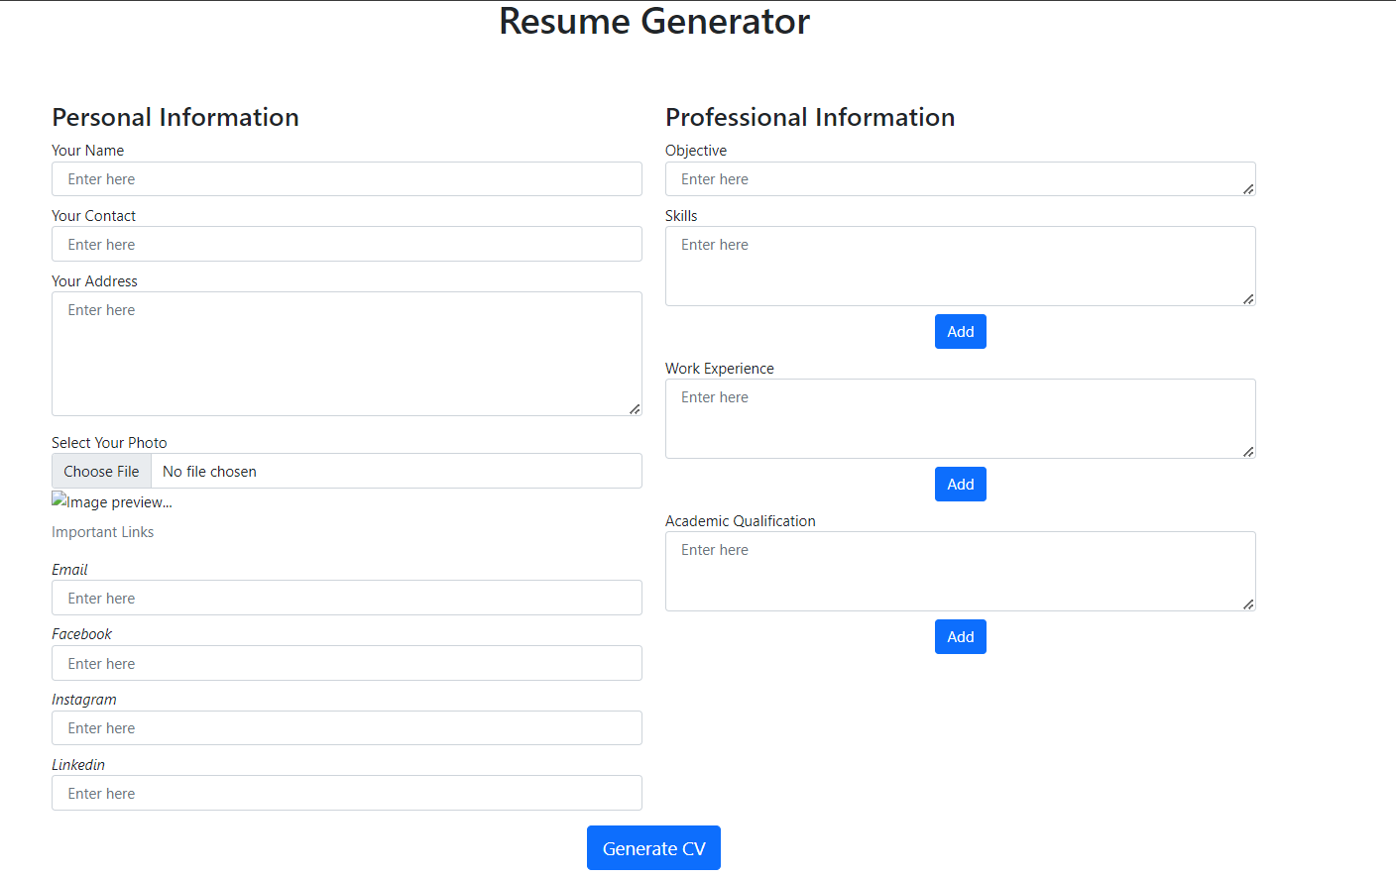
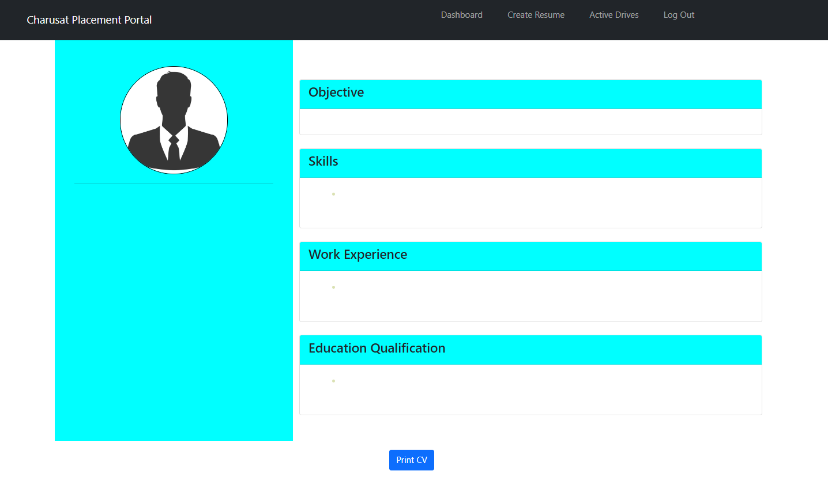
Resume Builder

Slide 19
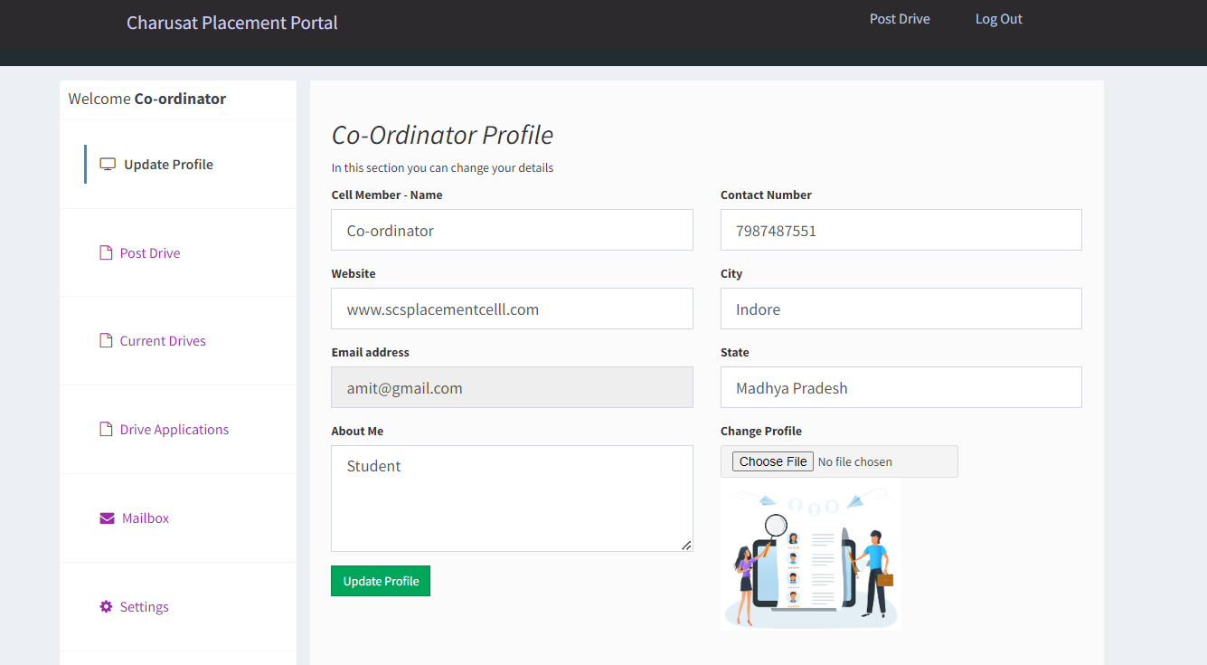
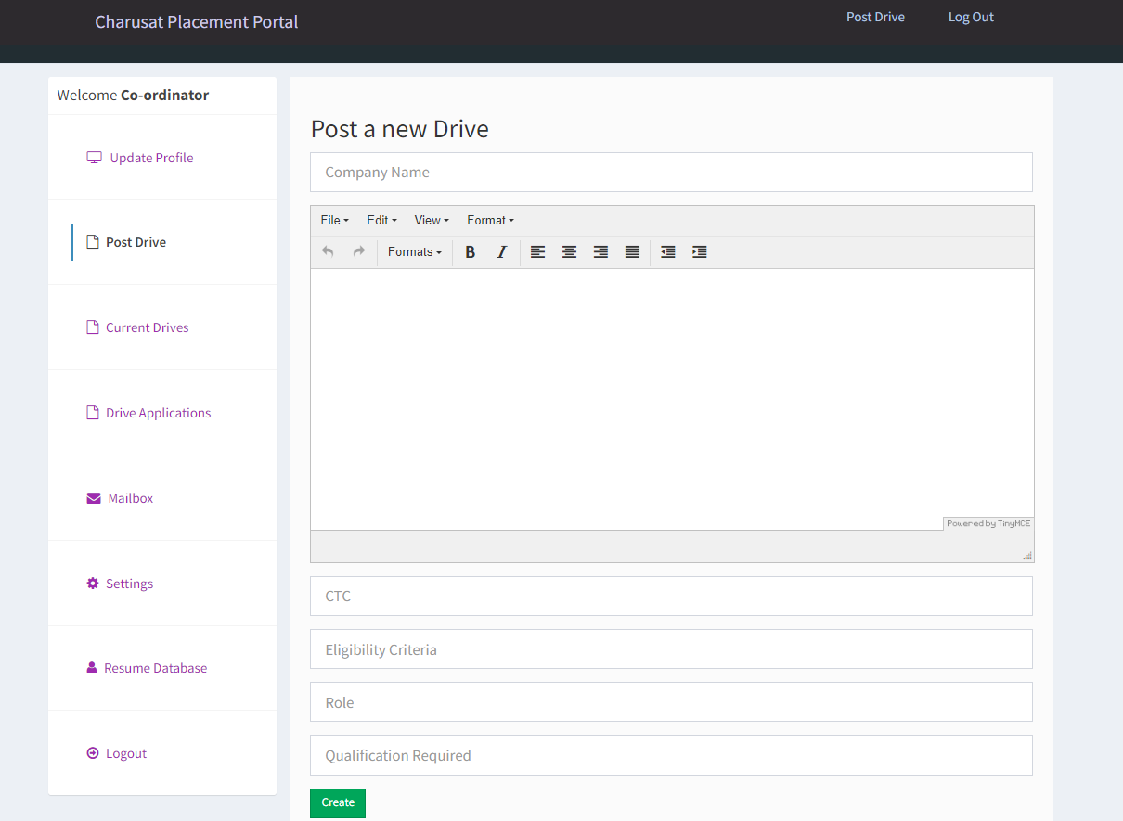
Co-ordinator Module

Slide 20
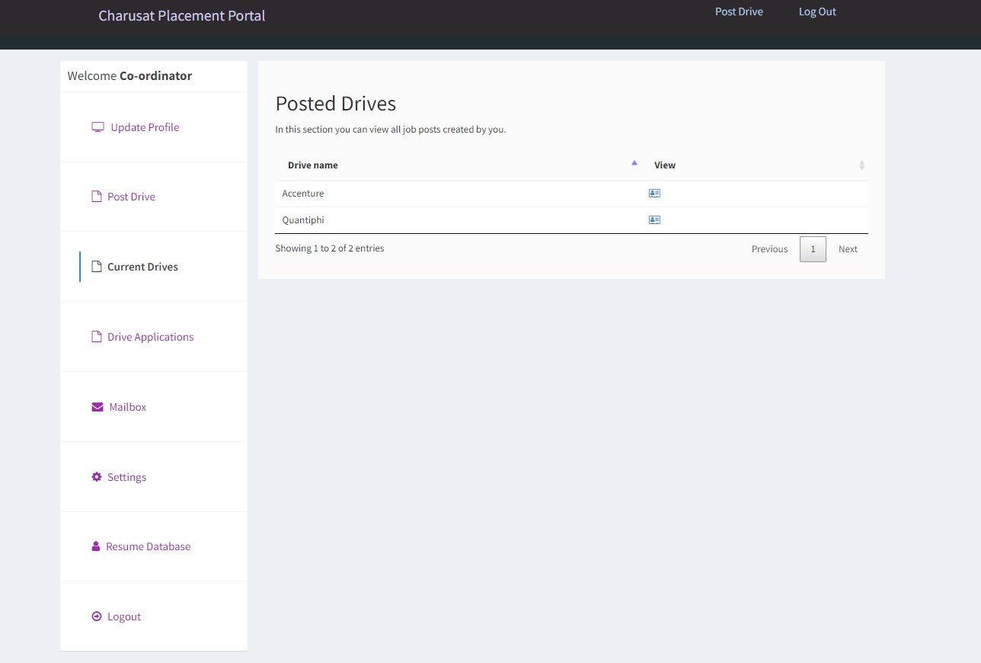
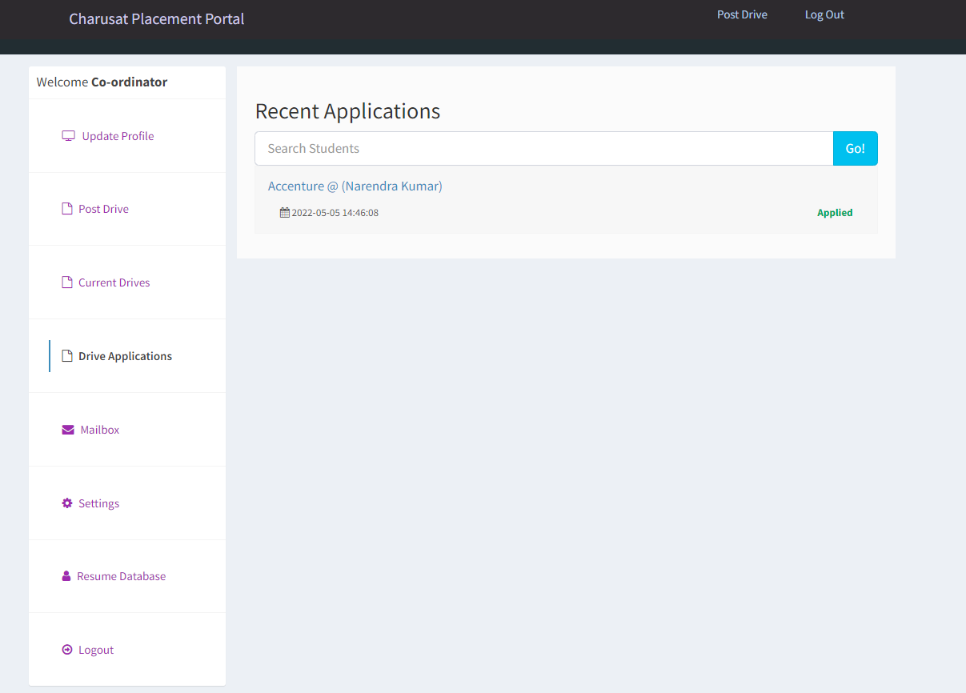
Co-ordinator Module

Slide 21
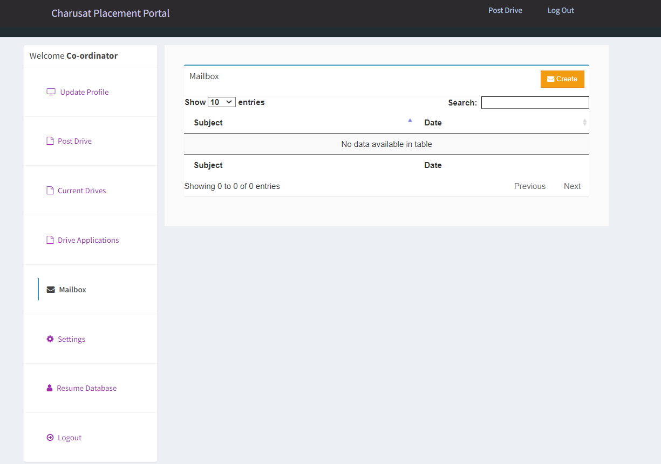
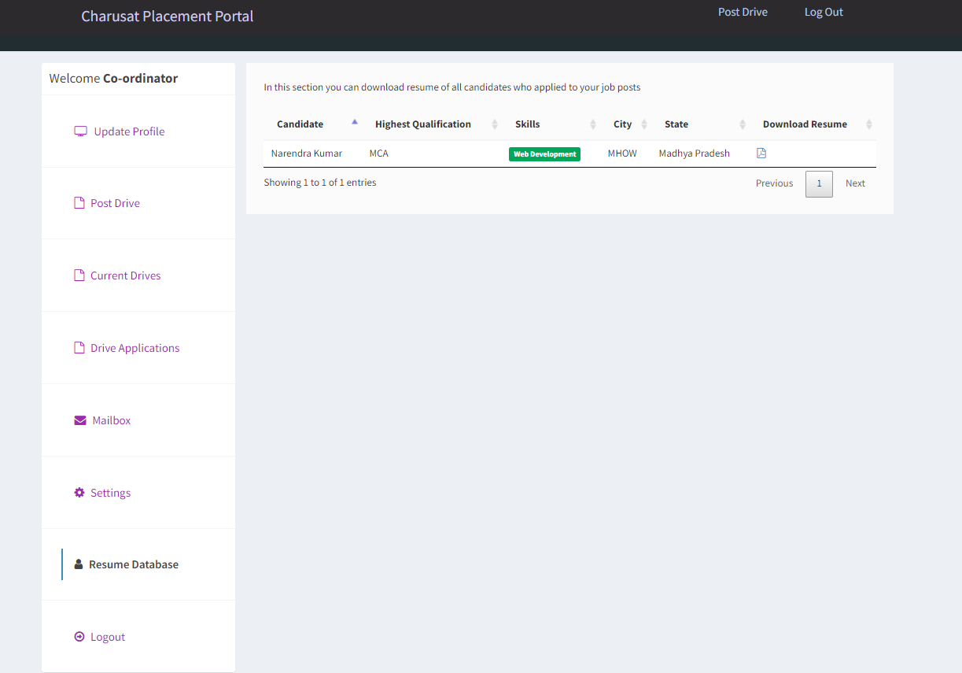
Co-ordinator Module

Slide 22
Thank You

